Slide 1
Object Oriented Programming Lab CSE 1206
LAB 2

Slide 2
Course Teacher Dr. Shahriar Mahbub, Professor Nowshin Nawar Arony, Lecturer Md. Hasin Abrar, Lecturer Md. Tanvir Rouf Shawon, Lecturer

Slide 3
Using Netbeans IDE Download link: https://netbeans.org/downloads/8.2/

Slide 4
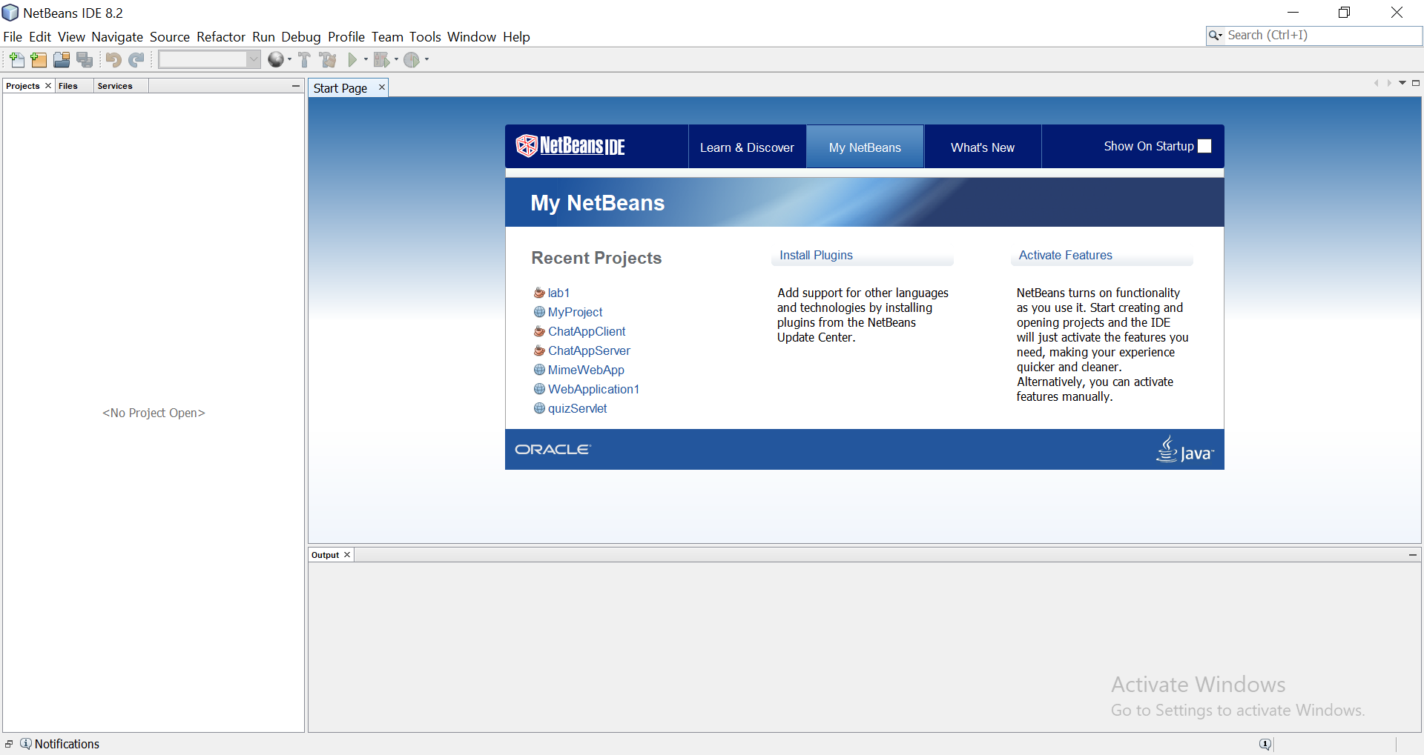

Slide 5
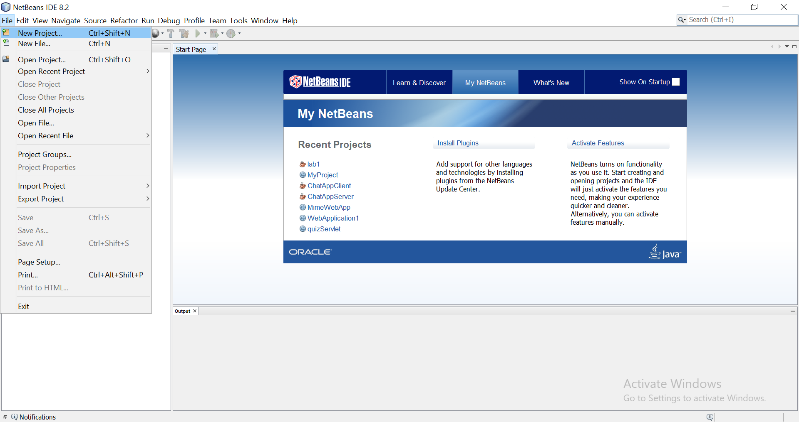

Slide 6
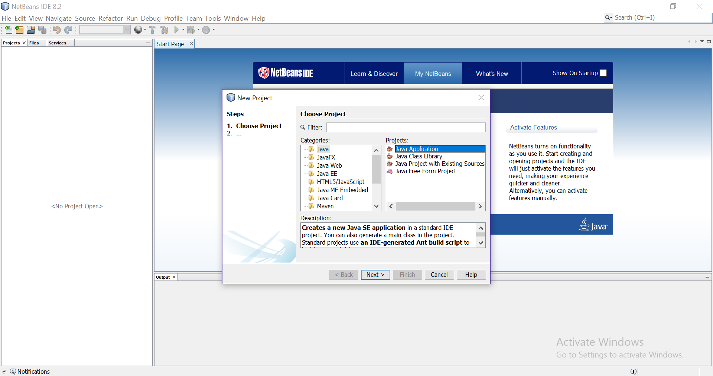

Slide 7
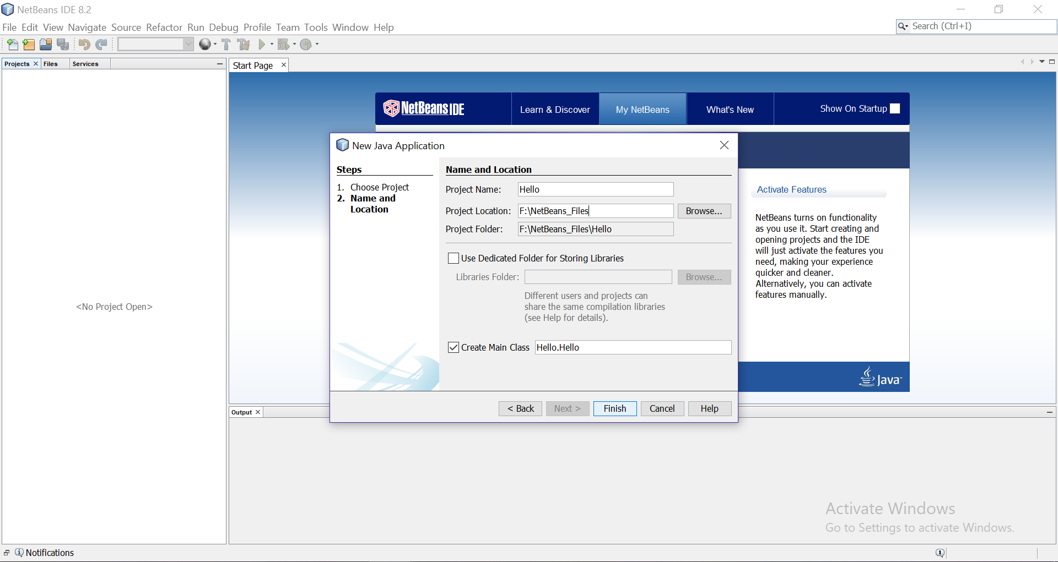

Slide 8
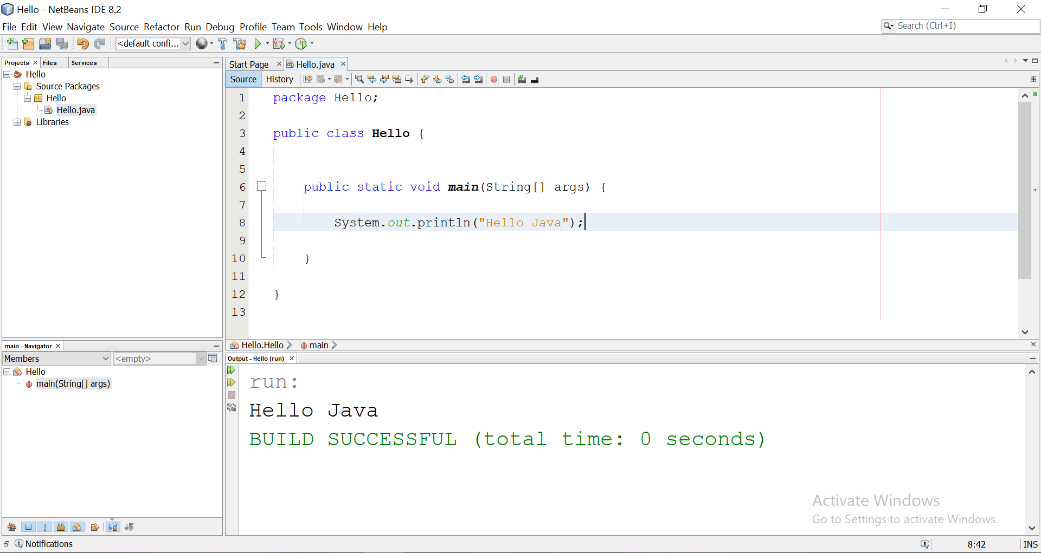

Slide 9

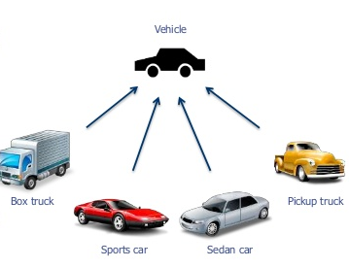

Slide 10


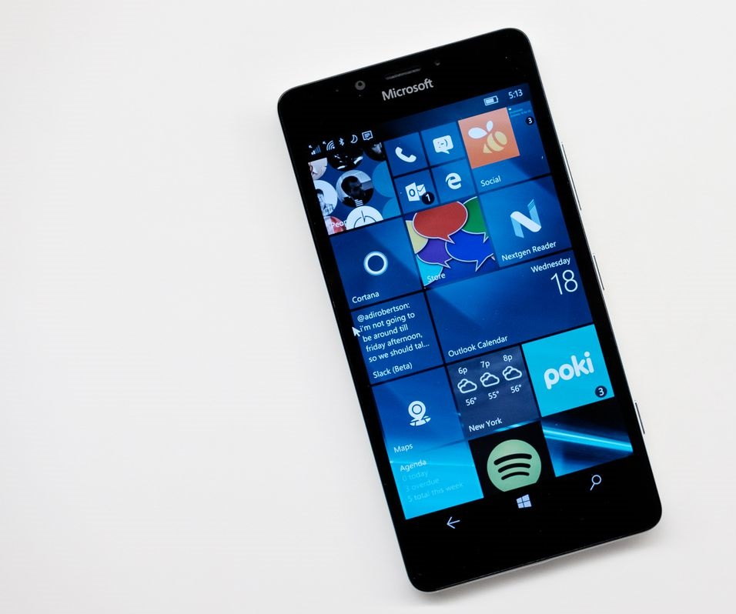
Java Class and Object
Class: SmartPhone
Object-1: iphone
Object-2 : Samsung phone
Object-3: Microsoft phone

Slide 11
Class
A basic smartphone has states or features like:
Makers
Operating System
Storage
Screen Size
Model
A basic smartphone has behaviors or functions like:
Power Duration
Camera
Interface
Each phone has its own features. So a class contains basic features and behaviors.
Fields

Slide 12
Java Class and Objects
A class is a new data type like int, double etc.
This data type is used to create objects.
So a class is a template for an object and an object is an instance of a class.

Slide 13
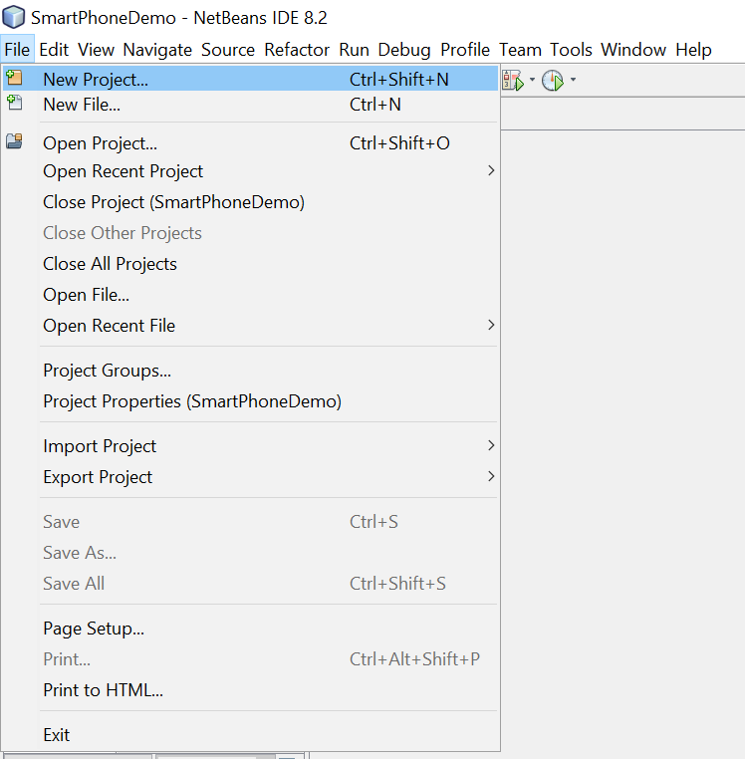
Create a New Project

Slide 14
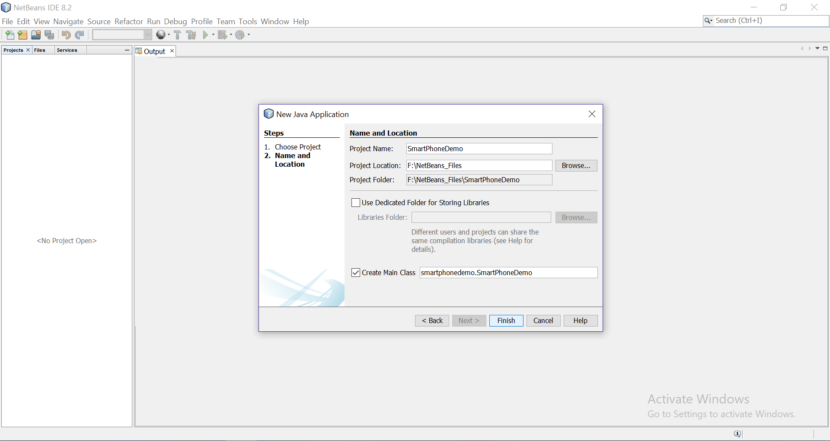

Slide 15
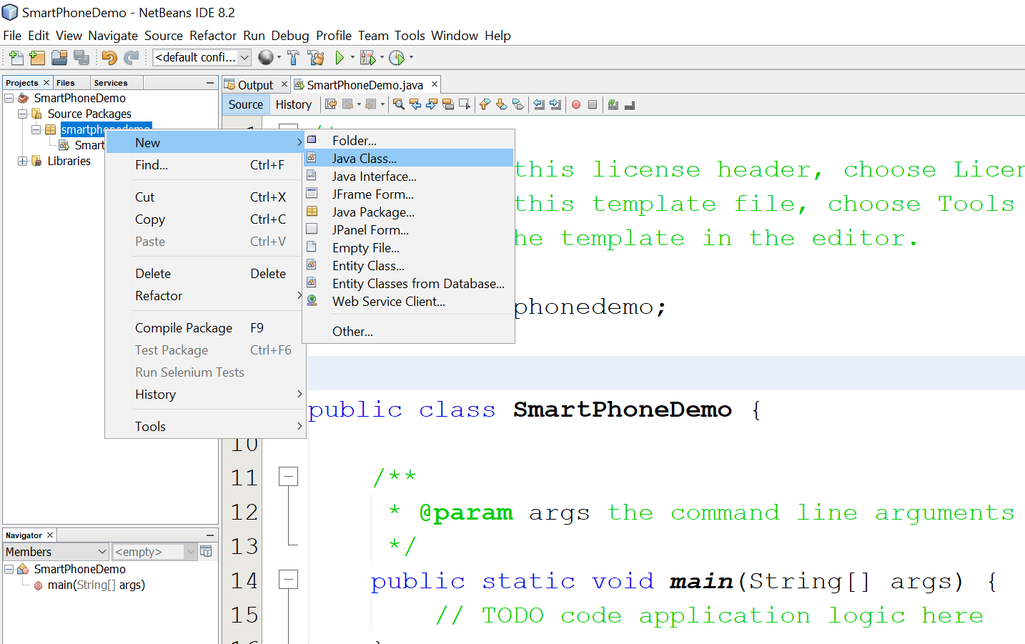

Slide 16
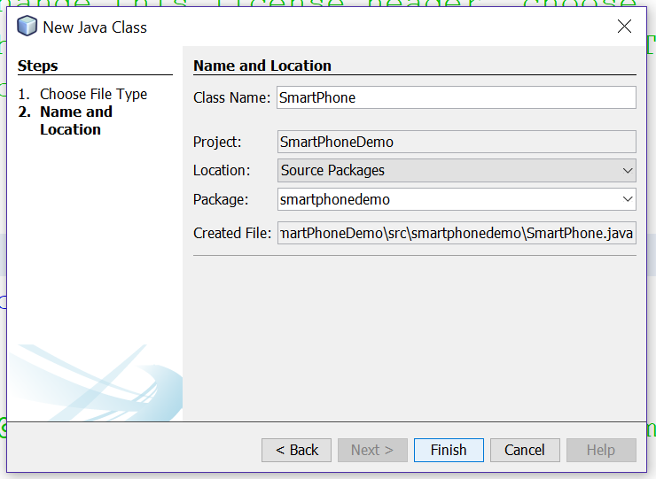

Slide 17
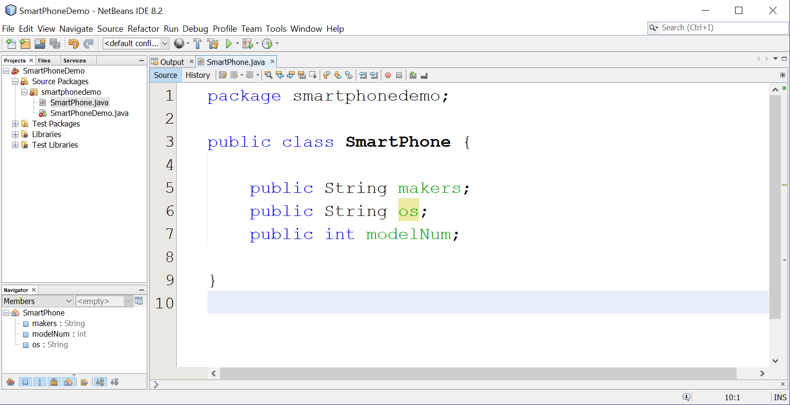

Slide 18
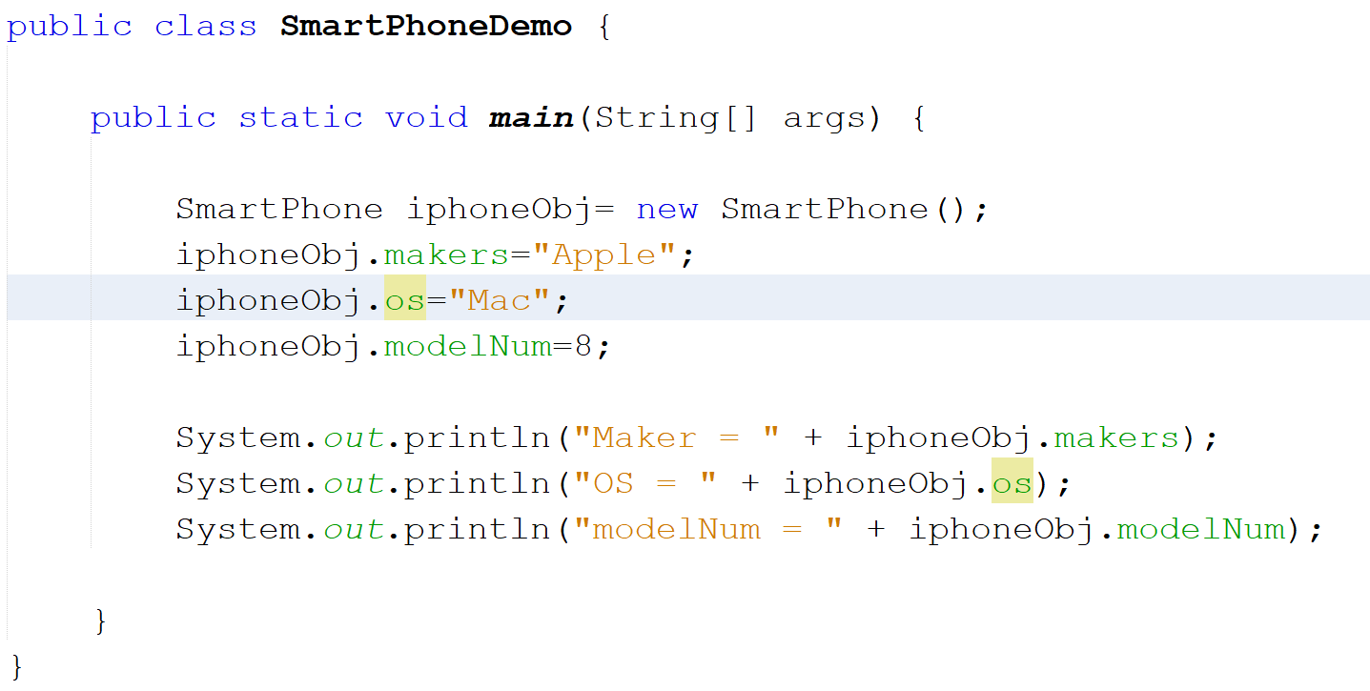

Slide 19
Introducing Methods

Slide 20
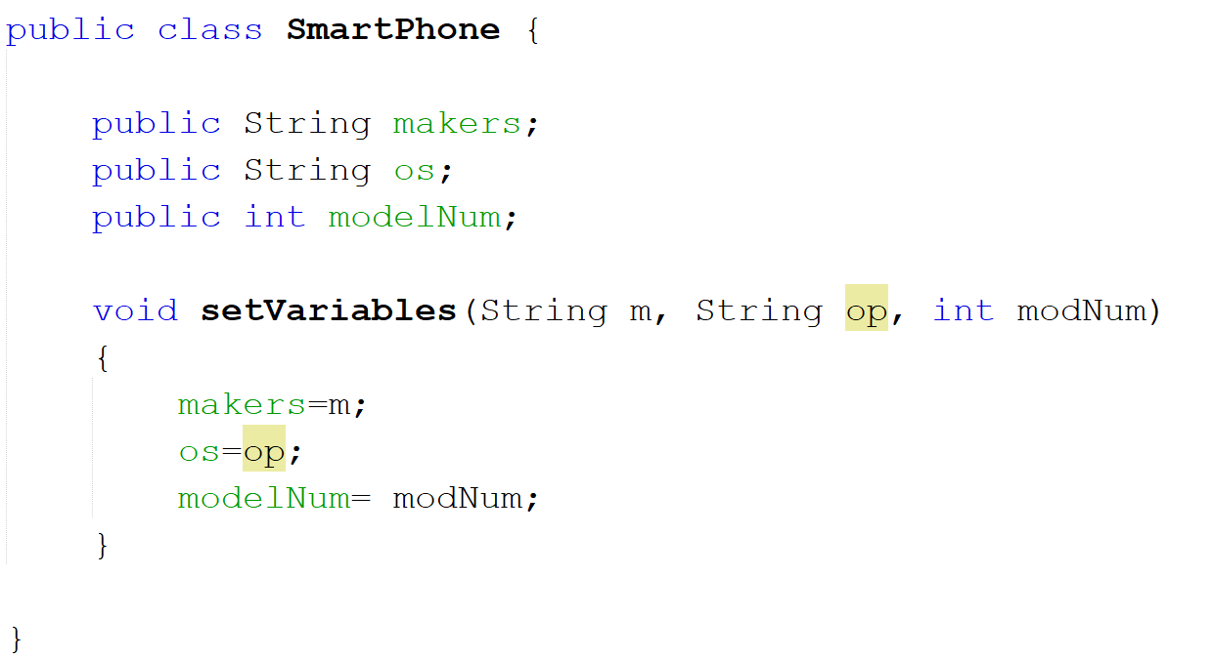

Slide 21
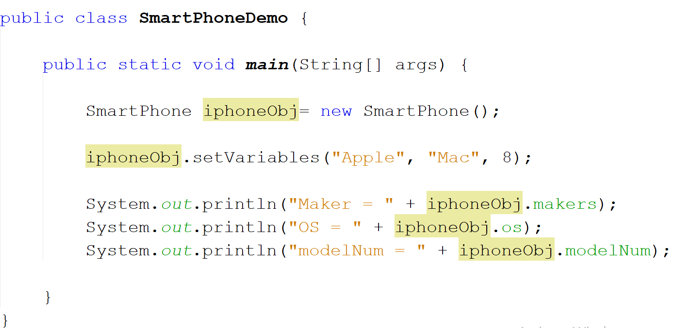

Slide 22
Constructors
Helps to initialize objects when they are created.
A constructor has the same name as the class.
Looks a method but has no return type. Not even void.

Slide 23
Constructor Overloading
creating constructors multiple times with different parameters.
smartphone(){
}
smartphone(double Storage, String Model){
}
smartphone(double Storage, String Model, double screenSize){
}

Slide 24
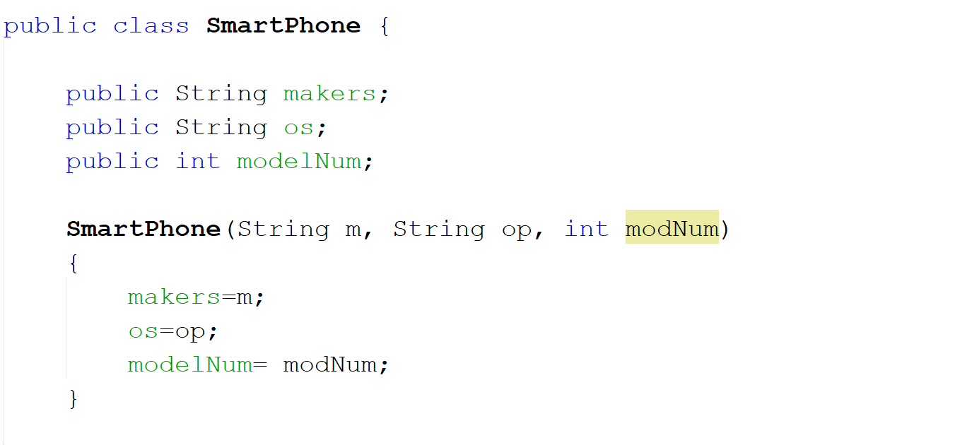

Slide 25
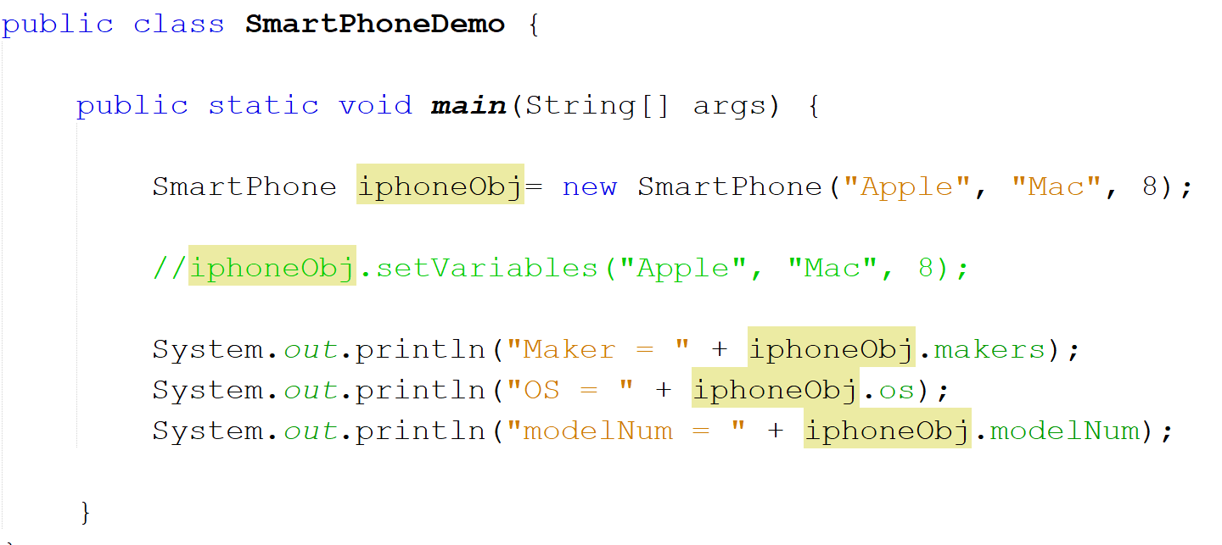

Slide 26
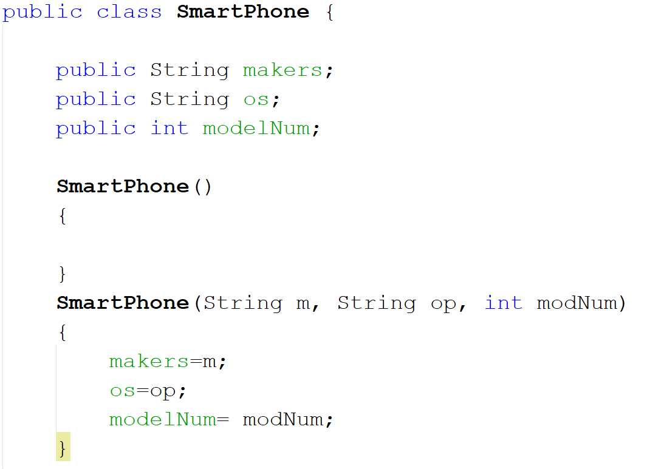
Default Constructor

Slide 27
this Keyword

Slide 28
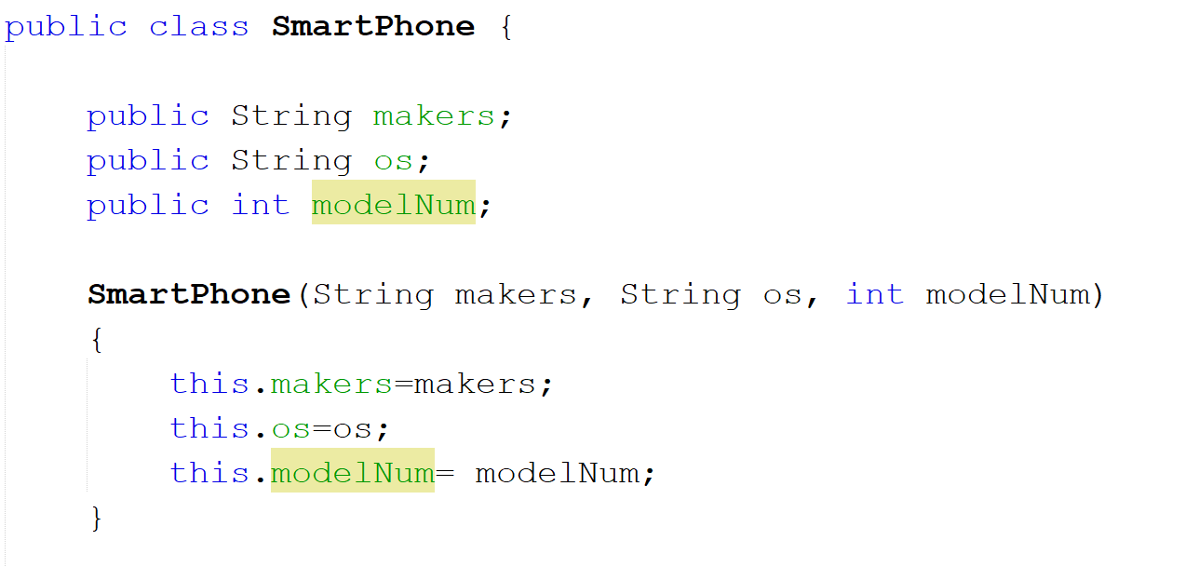

Slide 29
Try yourself
Class Name: Box
Variables : double length, double width, double height
Initialize using a constructor
Create a method: double getVolume() which returns the volume of the Box = length*width*height
Go to main method, create an object of Box class, assign values using constructor and print the volume.

